Slide 1
Module 9
Correlation

Slide 2
Prediction

Slide 3
Guessing the Future
Based on incomplete information
One way of making predictions:
To predict an outcome for an individual,
find others who are like that individual
and whose outcomes you know.
Use those outcomes as the basis of your prediction.

Slide 4
Association

Slide 5
Two Numerical Variables
Trend
Positive association
Negative association
Pattern
Any discernible “shape” in the scatter
Linear
Non-linear
Visualize, then quantify
(Demo)

Slide 6
Correlation Coefficient

Slide 7
Definition of r
Correlation Coefficient (r) =
average of
product of
x in standard units
and
y in standard units
Measures how clustered the scatter is around a straight line

Slide 8
The Correlation Coefficient r
Measures linear association
Based on standard units
-1 ≤ r ≤ 1
r = 1: scatter is perfect straight line sloping up
r = -1: scatter is perfect straight line sloping down
r = 0: No linear association; uncorrelated
(Demo)

Slide 9
Watch Out For ...
Nonlinearity
Outliers
Ecological Correlations

Slide 10
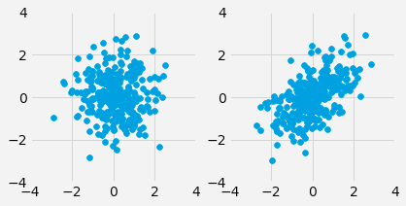
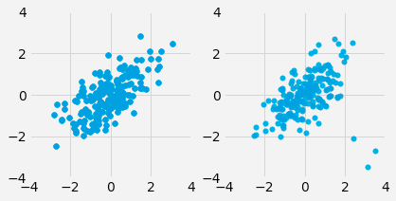
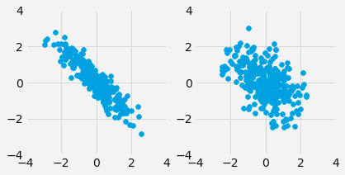
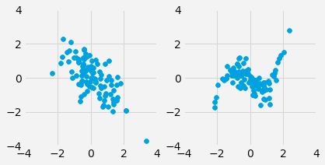
Discussion Question
For each pair, which one will have a higher value of r?
a)
c)
b)
d)

Slide 11
Lecture 28
Linear Regression

Slide 12
Correlation (Review)

Slide 13
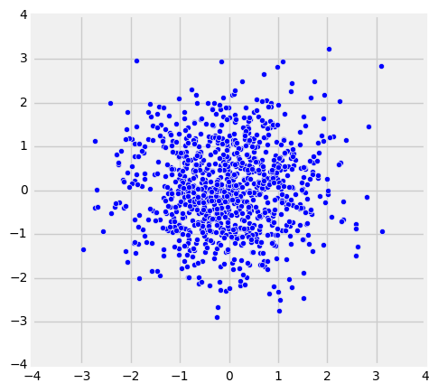
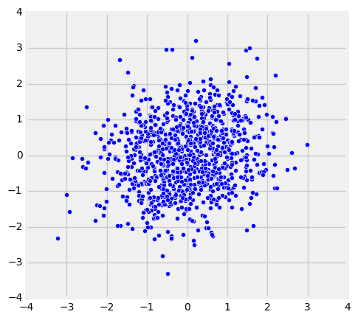
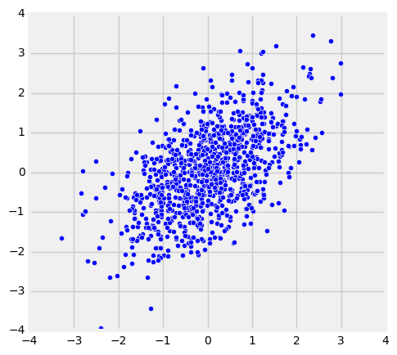
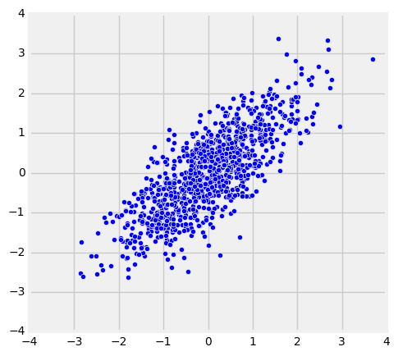
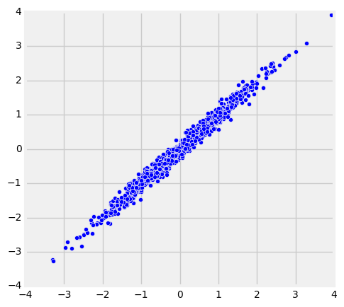
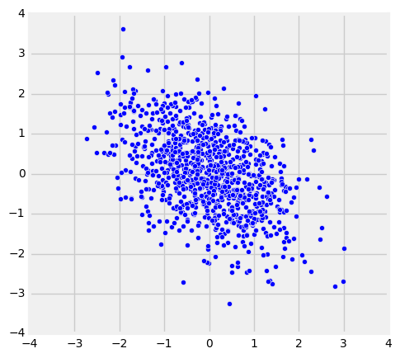
The Correlation Coefficient r
Measures linear association
Based on standard units
-1 ≤ r ≤ 1
r = 1: scatter is perfect straight line sloping up
r = -1: scatter is perfect straight line sloping down
r = 0: No linear association; uncorrelated
r = 0
r = 0.2
r = 0.5
r = 0.8
r = 0.99
r = -0.5

Slide 14
Definition of r
Correlation Coefficient (r) =
average of
product of
x in standard units
and
y in standard units
Measures how clustered the scatter is around a straight line

Slide 15
Properties of Correlation

Slide 16
Properties of r
r is a pure number, with no units
r is not affected by changing units of measurement
r is not affected by switching the horizontal and vertical axes

Slide 17
Interpreting r
Watch out for:
Jumping to conclusions about causality
Non-linearity
Outliers
Ecological correlations, based on aggregates or averaged data

Slide 18
Interpreting r
Don't jump to conclusions about causality

Slide 19
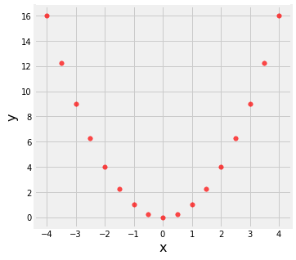
Interpreting r
Watch out for non-linearity.
r = 0.0

Slide 20
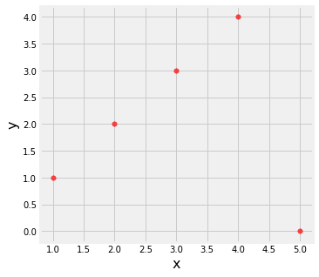
Interpreting r
Watch out for outliers.
r = 0.0

Slide 21
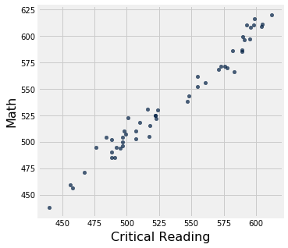
Interpreting r
Watch out for ecological correlations, based on aggregates or averaged data.
r = 0.98

Slide 22
Prediction

Slide 23
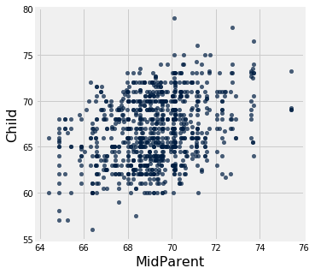
Galton's Heights

Slide 24
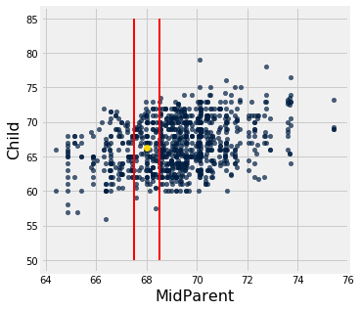
Galton's Heights

Slide 25
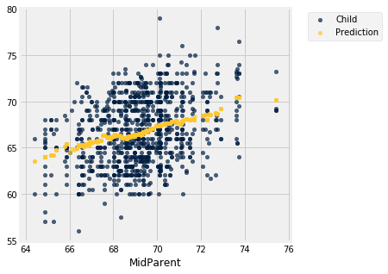
Galton's Heights

Slide 26
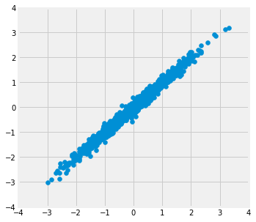
Where is the prediction line?
r = 0.99

Slide 27
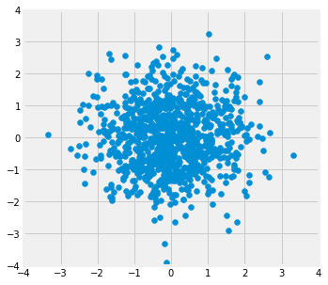
Where is the prediction line?
r = 0.0

Slide 28
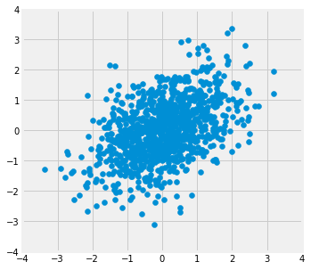
Where is the prediction line?
r = 0.5

Slide 29
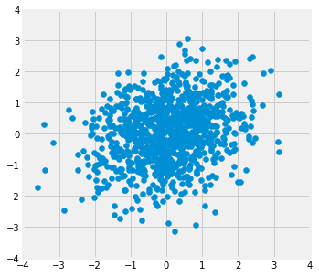
Where is the prediction line?
r = 0.2

Slide 30
Nearest Neighbor Regression
A method for prediction:
Group each x with a representative x value (rounding)
Average the corresponding y values for each group
For each representative x value, the corresponding prediction is the average of the y values in the group.
Graph these predictions.
If the association between x and y is linear, then points in the graph of averages tend to fall on the regression line.

Slide 31
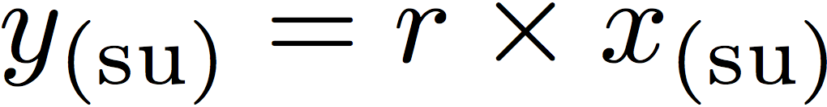
Regression to the Mean
A statement about x and y pairs
Measured in standard units
Describing the deviation of x from 0 (the average of x's)
And the deviation of y from 0 (the average of y's)
On average, y deviates from 0 less than x deviates from 0
Regression Line
Correlation
Not true for all points — a statement about averages

Slide 32
Linear Regression
(Demo)

Slide 33
Slope & Intercept

Slide 34
Regression Line Equation
In original units, the regression line has this equation:
y in standard units
x in standard units
Lines can be expressed by slope & intercept

Slide 35
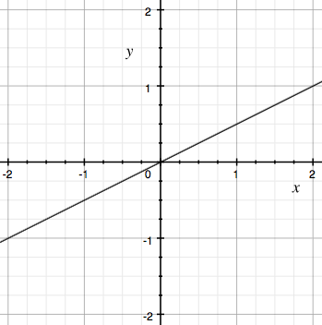
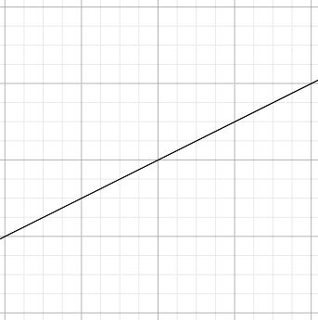
Regression Line
Standard Units
Original Units
(Average x, Average y)
(0, 0)
r
r * SD y
1
SD x

Slide 36
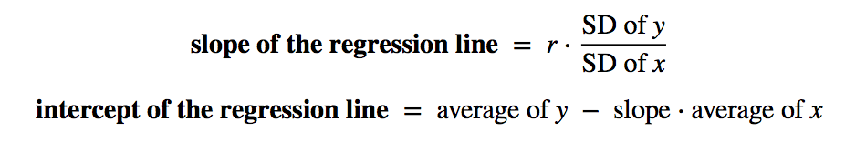
Slope and Intercept
estimate of y = slope * x + intercept
(Demo)

Slide 37
Module 9
Least Squares

Slide 38
Announcements

Slide 39
Algebra Review

Slide 40
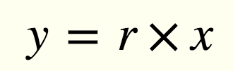
Equation of a Line
(0, 0)
r
1

Slide 41
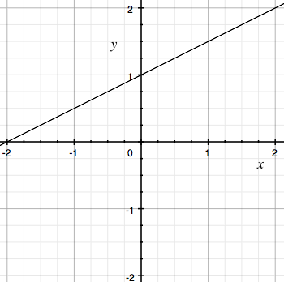
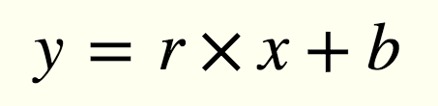
Equation of a Line
(0, b)
r
1
b

Slide 42
Linear Regression

Slide 43
Regression Line
Standard Units
Original Units
(Average x, Average y)
(0, 0)
r
r * SD y
1
SD x

Slide 44
Regression Line Equation
In standard units, the equation of the regression line is:
Fitted value
Observed value
(0, 0)
r
1
Correlation coefficient

Slide 45
Regression Line Equation
In original units, the regression line has this equation:
y in standard units
x in standard units

Slide 46
Discussion Question
A course has a midterm (average 70; standard deviation 10) and a really hard final (average 50; standard deviation 12)
If the scatter diagram comparing midterm & final scores for students has a typical oval shape with correlation 0.75, then...
What do you expect the average final score would be for students who scored 90 on the midterm?
How about 60 on the midterm?
y = 0.75 * 2 = 1.5
(Demo)

Slide 47
Least Squares

Slide 48
Error in Estimation
error = actual value − estimate
Typically, some errors are positive and some negative
To measure the rough size of the errors
square the errors to eliminate cancellation
take the mean of the squared errors
take the square root to fix the units
root mean square error (rmse)
(Demo)

Slide 49
Least Squares Line
Minimizes the root mean squared error (rmse) among all lines
Equivalently, minimizes the mean squared error (mse) among all lines
Names:
“Best fit” line
Least squares line
Regression line
(Demo)

Slide 50
Numerical Optimization
Numerical minimization is approximate but effective
Lots of machine learning uses numerical minimization
If the function mse(a, b)returns the mse of estimation using the line “estimate = ax + b”,
then minimize(mse)returns array [a₀, b₀]
a₀ is the slope and b₀ the intercept of the line that minimizes the mse among lines with arbitrary slope a and arbitrary intercept b (that is, among all lines)
(Demo)

Slide 51
Module 9
Residuals

Slide 52
Announcements

Slide 53
Residuals

Slide 54
Residuals
Error in regression estimate
One residual corresponding to each point (x, y)
residual = observed y - regression estimate of y
= observed y - height of regression line at x
= vertical difference between point and line
(Demo)

Slide 55
Residual Plot
A scatter diagram of residuals
Should look like an unassociated blob for linear relations
But still contains patterns for non-linear relations
Used to check whether linear regression is appropriate
(Demo)

Slide 56
Regression Diagnostics

Slide 57

Dugong
(Demo)

Slide 58
Properties of Residuals

Slide 59
Residual Variance
The mean of residuals is always 0, regardless of the original data
Variance is standard deviation squared: mean squared deviation
(Variance of residuals) / (Variance of y) = 1 - r²
(Variance of fitted values) / (Variance of y) = r²
Variance of y = (Variance of fitted values) + (Variance of residuals)
(Demo)

Slide 60
Discussion Question
How does the SD of the fitted values relate to r?
(SD of fitted) / (SD of y) = r
(SD of fitted) / (SD of y) = |r|
(SD of fitted) / (SD of residuals) = r
(SD of fitted) / (SD of residuals) = |r|

Slide 61
Regression Model

Slide 62
A “Model”: Signal + Noise
Distance drawn at random from normal distribution with mean 0
Another distance drawn independently from the same normal distribution

Slide 63
What We Get to See
(Demo)

